Slide 1
Changing the Face of Identity
Open Commerce In Publishing
Jonathan LeBlanc
Developer Evangelist: X.commerce
Email: jleblanc@x.com
Twitter: @jcleblanc

Slide 2
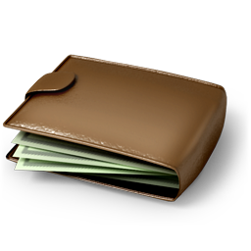


The Gist of This Talk

Slide 3

The Gist of This Talk: PayPal Access

Slide 4
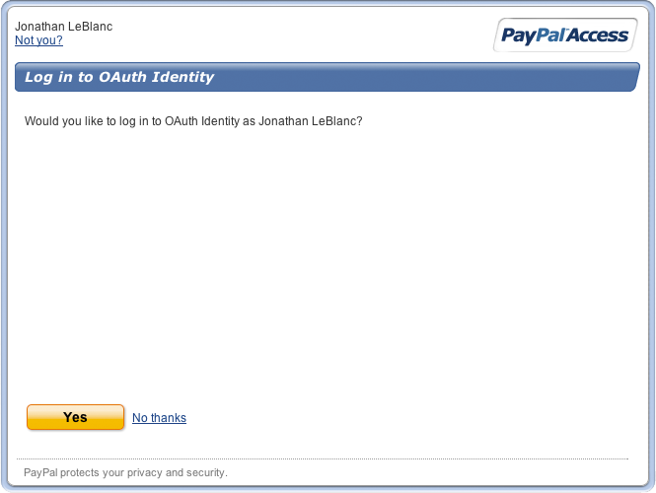
The Gist of This Talk: PayPal Access

Slide 5
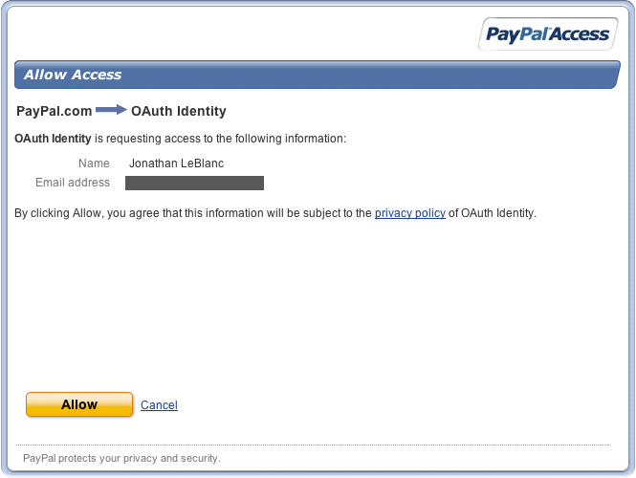
The Gist of This Talk: PayPal Access

Slide 6




What We’re Going to Cover
What is user identity?
How can you use grouping to personalize?
How do you pick the right identity tool?
How does PayPal Access help publishers?

Slide 7
What We’re Going to Cover
What is user identity?
How can you use grouping to personalize?
How do you pick the right identity tool?
How does PayPal Access help publishers?

Slide 8
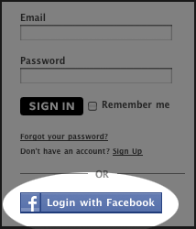
Identity: It’s Not Facebook

Slide 9
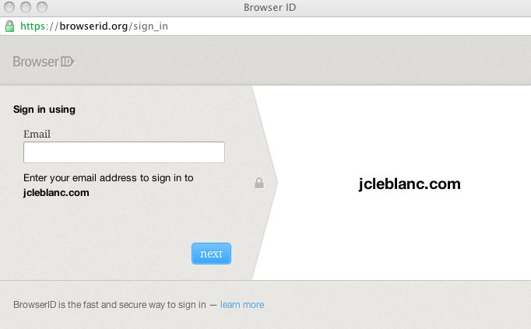
Identity: It’s Not BrowserID

Slide 10
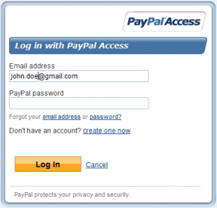
Identity: It’s Not Even PayPal

Slide 11

Identity: Login is Just the Tool

Slide 12



Identity: It’s Human Behavior

Slide 13
Identity: Statistics From User Browsing Data
Are you tracking what a user is viewing?
Are you categorizing your users?
Are you incentivizing your users?
Notes:
Are you tracking what a user is viewing? Use that data to personalize state & suggest products
Facebook likes hard to categorize (entire web) but publishers have a specific inventory that they control.

Slide 14
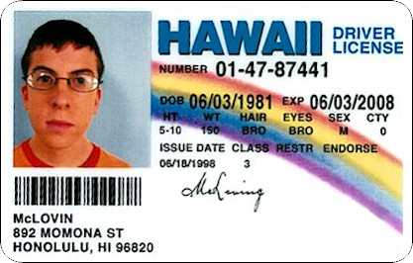
Identity: The Different Identity Models
Anonymous Identity

Slide 15
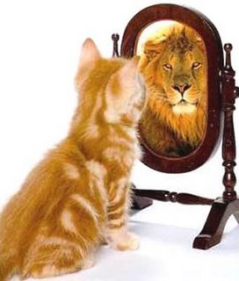
Identity: The Different Identity Models
Perceived Identity

Slide 16

Identity: The Different Identity Models
True (Verified) Identity

Slide 17

What Have We Learned Thus Far?
Identity is more than just a login
Notes:
Identity should include user historical buying data and what they have viewed – recommendation engine

Slide 18
What We’re Going to Cover
What is user identity?
How can you use grouping to personalize?
How do you pick the right identity tool?
How does PayPal Access help publishers?

Slide 19

Grouping: Users Get Confused
Notes:
Many times you will have users that aren’t exactly sure what they want
Through monitoring their browsing and buying behavior you can find “like” users
From “like users”, you can recommend products and guide users to products they may like.

Slide 20

Grouping: Find People With Like Interests

Slide 21



Grouping: Recommended Products

Slide 22

What Have We Learned Thus Far?
Identity is more than just a login
Grouping provides insight into users
Notes:
Identity should include user historical buying data and what they have viewed – recommendation engine

Slide 23
What We’re Going to Cover
What is user identity?
How can you use grouping to personalize?
How do you pick the right identity tool?
How does PayPal Access help publishers?

Slide 24
Identity Tools: Proprietary or Open?
23 % of customers abandoned carts when asked to register. (Forrester)
45 % left a site when they couldn’t remember their password. (Blue Inc)

Slide 25
Identity Tools: It’s Simpler Than You Think
Do you sell anything?
What kind of raw user data do you need?
In what ways do you want to personalize your product with identity?

Slide 26

Identity Tools: Selling Goods

Slide 27
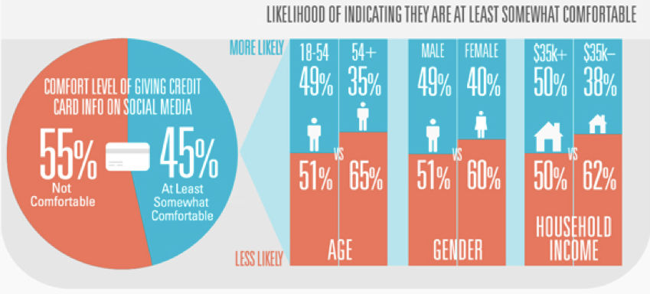

Identity Tools: Selling Goods
Graph source provided by Digitas (http://rww.readwriteweb.netdna-cdn.com/teaser.jpg)

Slide 28
Identity Tools: Raw User Data
{
"addresses":[{
"state":"CA”,
"street1":"1339 moonlight way”,
"city":"New York",
"zip":"92345”
}],
"emails”:["john_smith22@yahoo.com"],
"firstName":"John",
"lastName":"Smith",
"telephoneNumber":"2123935554”
}

Slide 29

Identity Tools: Personalization

Slide 30

What Have We Learned Thus Far?
Identity is more than just a login
Grouping provides insight into users
The right tool should work for your needs
Notes:
Identity should include user historical buying data and what they have viewed – recommendation engine

Slide 31
What We’re Going to Cover
What is user identity?
How can you use grouping to personalize?
How do you pick the right identity tool?
How does PayPal Access help publishers?

Slide 32
PayPal Access: The Core Principals
Identity is more than just a login
Grouping provides insight into users
The right tool should work for your needs
Notes:
Identity should include user historical buying data and what they have viewed – recommendation engine

Slide 33
PayPal Access: The Raw Data
Verified Account
Language
First Name
Last Name
Full Name
Emails
Addresses
Telephone Number
Date of Birth
Time zone
Gender

Slide 34
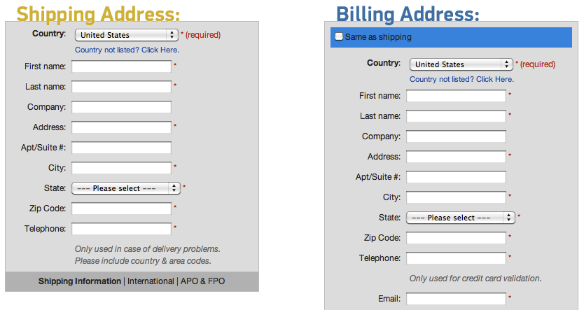
PayPal Access: Using the Raw Data

Slide 35
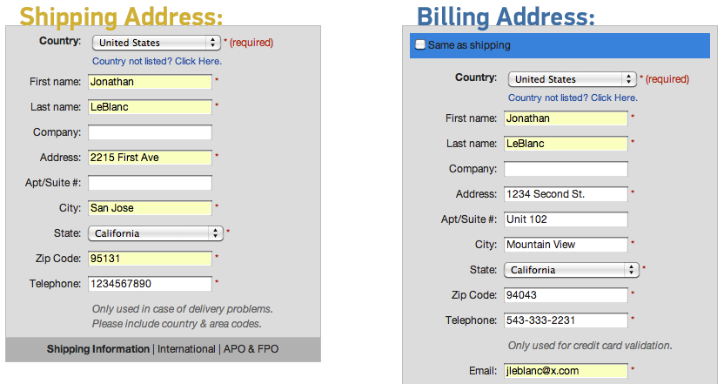
PayPal Access: Using the Raw Data

Slide 36




PayPal Access: The Data Sources
Transaction
Recency
Activity Class
Transaction
Frequency
Average Spent

Slide 37



Extending Identity with Recommendations
Recommended Products
Similar
Products

Slide 38

Group Dynamics with Prospect Scores

Slide 39
In The End…
Data should help, not hinder
Identity should help extend your business

Slide 40
Thanks for joining me! Questions?
Slides: https://bitly.com/tocidentity
Jonathan LeBlanc
Developer Evangelist: X.commerce
Email: jleblanc@x.com
Twitter: @jcleblanc

